Slide 1
DevOps Basics
Introduction
A clipped compound of Development and Operations
Buzzword
Innovation for automation (pillar of DevOps)
DevOps is an approach based on lean and agile principles
There are more tangential DevOps Initiative
WinOps
DevSecOps
BizDevOps

Slide 2
DevOps Basics
Introduction Contd..
Definition of DevOps:
“DevOps is a set of practices intended to reduce the time between committing a change to a system and the change being placed into normal production, while ensuring high quality”
Implications of this definition
Practices and tools
Do not restricted scope of DevOps to testing and development

Slide 3
DevOps Basics
Need for DevOps
Developer :- Writing Code
Quality Assurance :- Testing
Operations personnel :- Deploy
QA
Operator
Code

Slide 4
DevOps Basics
Need for DevOps Contd..
Developer
Tester
Operator
BUG
FIX
When

Slide 5
DevOps Basics
Need for DevOps Contd..
Product Release
Feature A
Feature B
Existing Bugs
Bug 1
Bug 2
New Features
Bug Fix

Slide 6

DevOps Basics
Need for DevOps Contd..
https://in.pinterest.com/

Slide 7
DevOps Basics
Need for DevOps Contd..
Waterfall Model
Dominated Project Management Until 2001
Still in Use :
Disciplined Approach
Thorough Scoping
Clear Stages
Concrete Deadlines
Disadvantages:
Sequential
Inflexible
Assumptions
We are loosing Time to market

Slide 8
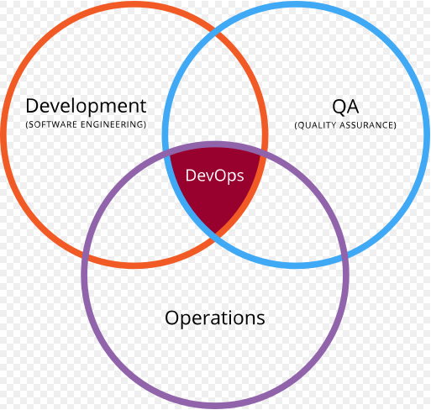
DevOps Basics
Where is Operations?
Development is All Well
Where is Operations?
Where is System Administrators?

Slide 9
DevOps Basics
Why DevOps? :: Lets Summaries
Release Process
Releasing a new system or version of an existing system to customers is one of the most sensitive steps in the software development cycle
The following release planning steps are adapted from Wikipedia
Define and agree on release and deployment plans with customers/stakeholders
Ensure that each release package consists of a set of related assets and service components that are compatible with each other
Ensure that the integrity of a release package and its constituent components is maintained throughout the transition activities and recorded accurately in the configuration management system
Ensure that all release and deployment packages can be tracked
Poor Coordination
Limited Capacity of Operations Staff

